Slide 1
The Power of Christ
Luke 4:31-6:11

Slide 2
The Authority of Christ
Power shown on earth, John 5:18-23; 17:2, 4
Announced after His resurrection, Matthew 28:18-20
Prophecy of His ruling authority fulfilled, Psalm 110:1-3; Acts 2:33-36
Luke 4:31-6:11 Events showing His authority

Slide 3
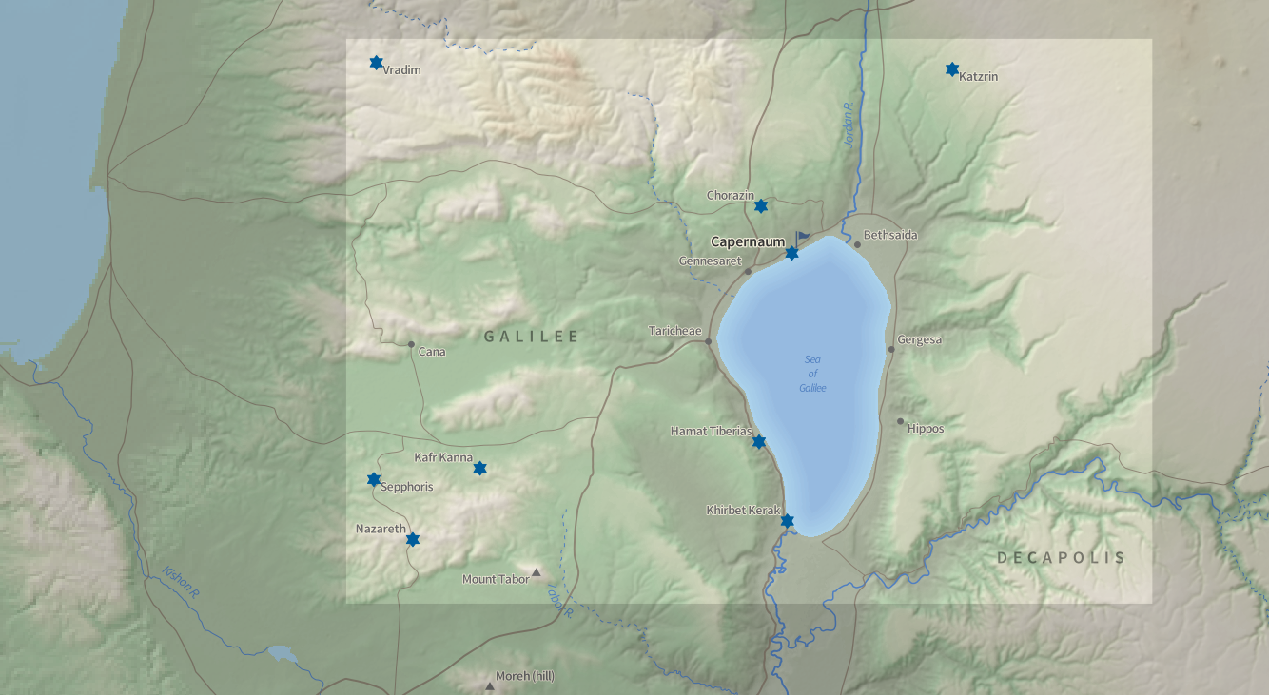
3

Slide 4
The Authority of His Word Luke 4:31-32, 42-44
He commands and defeats sin with His word, Acts 2:40-41
The content and urgency of His preaching, Luke 4:43-44; Romans 10:13-17
Jesus will command death with His word, John 5:28-29
We will be judged by His word, John 12:48; Revelation 20:12

Slide 5
His Authority over Demons Luke 4:33-37, 41
Shows His power over Satan, Luke 11:20-22
We rely on Christ’s power in our struggle against forces of evil, Ephesians 6:10-13

Slide 6
His Authority over Sickness Luke 4:38-40
Foretold His power over sin, Matthew 8:14-17
Prayer avails, Luke 4:38; James 5:14-15
By the power of His grace, we are made strong in weakness, 2 Cor. 12:7-10

Slide 7
His Authority over Nature Luke 5:1-11
Peter put his faith in Christ’s word, Luke 5:3-5
Produced a great catch of fish, and Peter’s confession of sins, Luke 5:6, 8
Signified Christ’s power to save lost humanity, Luke 5:10

Slide 8
His Authority over Leprosy Luke 5:12-16
Christ is willing and able to heal the most corrupt, Luke 5:12-13
Like this man, we must fall on our faces and implore Jesus to heal us!

Slide 9
His Authority to Forgive Sins Luke 5:17-26
Jesus sees faith, and forgives sins, Luke 5:20; Acts 2:37-38, 41; 22:16
“Strange things” – Beyond expectation, Luke 5:26; Ephesians 2:1, 4-6

Slide 10
His Authority over Cultural Norms Luke 5:27-32
He defied human expectations to achieve divine purposes, Galatians 1:10 (2 Cor. 5:9; Jno. 8:29)
Culture does not set our moral standard, conscience and faith; Christ does

Slide 11
His Authority to bring in New Things Luke 5:33-39
Jesus had power to introduce a new covenant, with better blessings, Hebrews 8:6
Men’s expectations do not establish divine approval

Slide 12
His Authority over the Sabbath Luke 6:1-11
Jesus had power to use the Sabbath, Luke 6:1-5 (2, 5)
He did not violate it
Jesus had power to explain the purpose of the Sabbath, Luke 6:6-11 (9)

