Slide 1
The Healer
Matthew 8:14-17

Slide 2
Charlie Goldsmith
(Energy Healer)

Slide 3
Charlie Goldsmith, aka “The Healer”
“In the 17 years since the bewildering day that Charlie Goldsmith discovered what he calls his “gift,” the 35-year-old energy healer from Melbourne, Australia, has been trying to get someone in the medical world to take him seriously. He has wanted to be of use, working with the formal sanction of doctors in hospitals.

Slide 4
Charlie Goldsmith, aka “The Healer”
“He has wanted to be recognized for what he knows he can do—not simply to justify the strange turn his life took when he was 18, but to shore up the credibility of a practice long plagued by fraud and religious superstition, and to make the experience of discovering and developing a healing gift like his less traumatic for other people.”
“Energy Healing Works—Many Say. But How Do You Prove It?”
Chip Brown, Elle, Sept. 21, 2015

Slide 5
Energy Healing
“Today some 200 studies (published in peer-reviewed science journals but, for the most part, not in prominent medical ones) have detailed the apparent effects of energy healers on the physiology of humans, animals, plants, bacteria, and cells in culture, and even on the activity of enzymes. As pioneering medical researchers in the last two decades have explored how the mind can change the body—

Slide 6
Energy Healing
“—how objective physiological indices of health can be influenced by the subjective reality of emotions, thoughts, intentions, expectations, environmental conditions, beliefs, social relationships, and prayers—medical science has begun to appreciate the intricate reciprocity of psyche and soma.” (Ibid)

Slide 7
Credible, or Fraudulent?
“I wanted to be studied,” he said. "I kept wondering, What is it going to take for people to stop and say, ‘This is pretty compelling’? If you’re good in tennis, if you’re good in math, there’s a path; there are people to talk to; you can prove yourself. If you’re a healer, what’s the path? You can work out of a second bedroom, but it’s borderline illegal and you never have any real credibility.” (Ibid)

Slide 8
Jesus is the Great Physician
Matthew 9:5-8
8

Slide 9
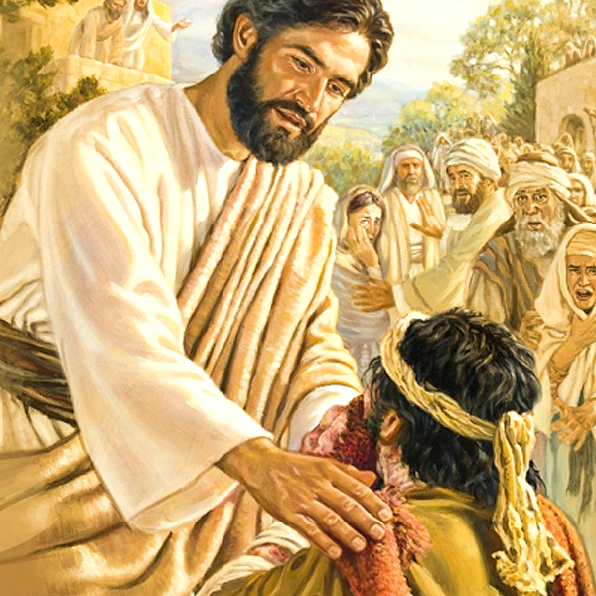
Jesus: The Healer
Healed all kinds of sickness and diseases, Matthew 4:23-24
“What is neglected, disparaged, and dismissed by critics of energy medicine is the well-recognized placebo effect, which represents the power of self-healing," says Daniel J. Benor, MD, an American psychotherapist living in Canada and a leading advocate of an energy-based holistic approach to medicine; his four-volume Healing Research is the definitive compendium of healing studies. “Whatever else they may do,” he says, “it is evident healers are experts in promoting self-healing.”
9

Slide 10
Jesus: The Healer
Healed without being present, Luke 7:1-10
Goldsmith claims EH via phone calls, other rooms, etc.
Touched, and was touched, Matthew 8:2-3; 9:20-22
Goldsmith claims EH ability to heal without physical contact
10

Slide 11
Jesus: The Healer
Immediately and completely (without relapses), Matthew 8:3; 14:35-36
EH cannot claim this
Miracles testified He is from God, John 5:36; Acts 2:22; 10:38
Faith that Jesus is the Son of God, Matthew 11:2-6; John 20:30-31; 10:25, 38; 11:42
11

Slide 12
Problems with “The Healer”
Potential of being deceived
Some will believe he is a miracle worker
Bible miracles: “works of a supernatural origin and character, such as could not be produced by natural agents and means…”
Supernatural intervention that defies nature, John 6:19; 11:39, 43-44
12

Slide 13
Problems with “The Healer”
Energy healer’s faith-denying potential
When some take it to be miraculous
Unscrupulous will exploit the weak, Acts 8:9-11
13

Slide 14
Time of Miracles Over (Purposes Fulfilled)
Complete Authentication
John 20:30-31
Galatians 1:11
Complete Revelation
2 Tim. 3:16-17
2 Peter 1:3-4
Complete Standard for Testing
Hebrews 4:12
1 John 4:1, 6
People are susceptible to the deception that Energy Healing is a spiritual, divine power – a divine calling
Lying wonders, 2 Thessalonians 2:9-10

Slide 15
Jesus: Healer of Souls
Healing bodies a prelude to healing souls, Matt. 8:14-17
Purpose, Isaiah 53:4
Bore our transgressions in death, to heal souls from sin, Isaiah 53:5-6; 1 Peter 2:24
Humble hearts of faith are healed, John 12:37-40; Matthew 11:28-30; Acts 2: 37-38, 41
15

Slide 16
Temporary relief
Cannot heal soul
Eternal relief of soul
H-B-R-C-B / Faithful

