Slide 1
-Tried to run, Jonah 1 -God prepared fish, 1:17 -Jonah obeyed, Jonah 3:2-3 -Sign to the Ninevites, Lk. 11:29-30; Matt. 12:38-41
Jonah’s Conversion

Slide 2
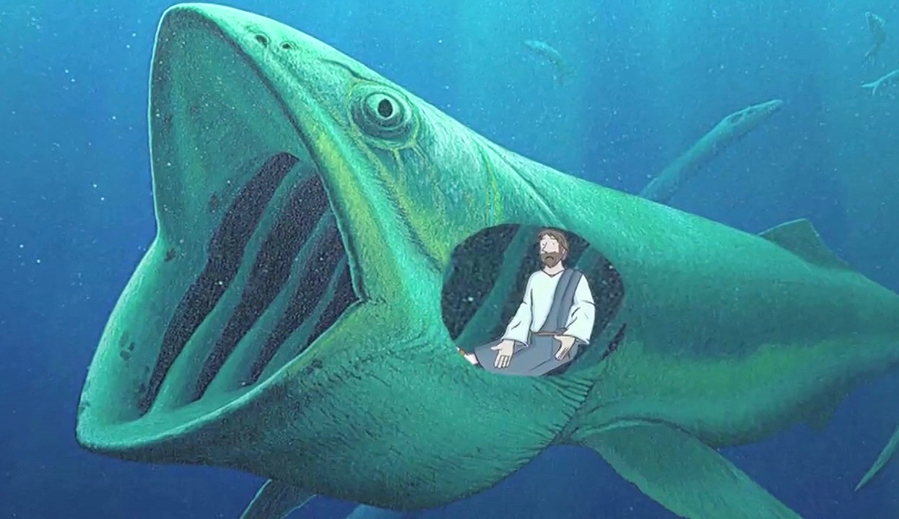
ECHOES FROM THE BELLY OF A FISH
Jonah 2

Slide 3
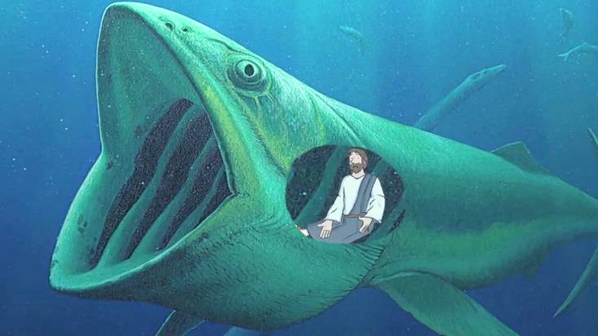
You cannot hide from God (1:1-3)
Cannot hide our hearts from God, Heb. 4:13
Knows our thoughts, actions and words, Psalm 139:1-4
No hiding place from Him, Psalm 139:7-12

Slide 4
You cannot hide from God (1:1-3)
Our moment of flight can become our moment of salvation
God prepares mercy, Jonah 1:17
Prodigal son, Luke 15:17-20

Slide 5
God hears and answers our prayers when we turn our hearts to Him (2:1-2)
Power of penitent prayer, Acts 8:22-24; 1 John 1:9
Power of righteous people praying, James 5:15-18
God delivers us from sin when we repent and look to Him, Jonah 1:17; 2:4, 6-7

Slide 6
God disciplines us with trials so we will remember Him (2:3-7)
God uses trials to discipline us, Hebrews 12:3-6, 9-10
Requires faith to see the blessings of trials, 2:6; Hebrews 12:11; 1 Peter 4:12-13, 16 (James 1:2-3)
Take courage and be strong, 2 Corinthians 12:8-10

Slide 7
Salvation is of the Lord (2:9-10)
Idols are worthless to save, Jonah 2:8
False religions, money and possessions, wisdom, power, fame
Idolatry comes from human wisdom, and is fed by fleshly lusts, Romans 1:21-27; cf. Colossians 3:5

Slide 8
Salvation is of the Lord (2:9-10)
Salvation does not excuse us from our vows to God, Jonah 2:9; Ecclesiastes 5:1-5
Graciously do our duty, Luke 17:10 (1 John 5:3)
Fear God and obey Him, Eccl. 12:13-14; Hebrews 5:8-9

Slide 9
Obedience is empty without thanksgiving (2:9)
We obey God because we adore Him and thank Him for His mercy, 1 Timothy 1:12; Romans 6:17-18
Repentance is essential before you can do God’s work, Jonah 2:7-3:4 (Luke 22:31-32; Joshua 24:14)

Slide 10
-Cannot hide -Prayer works -Trials discipline us -Salvation is from the Lord -Obey out of thanksgiving
Echoes from the Belly of a Fish

