Slide 1
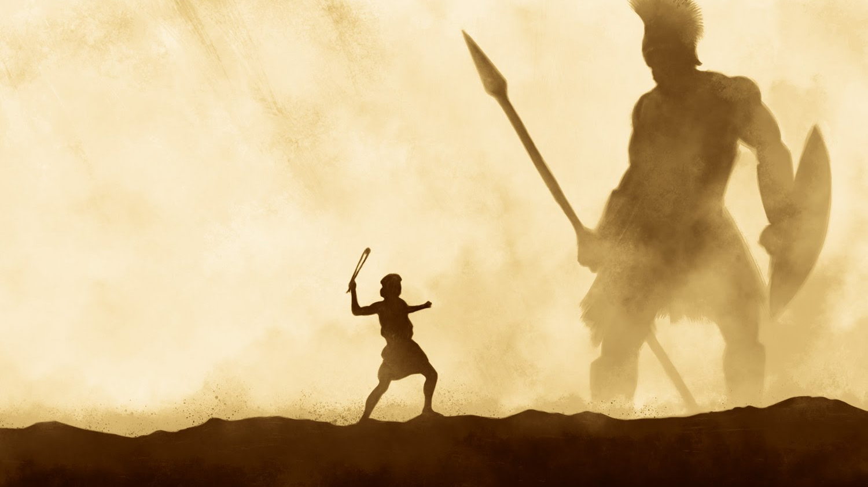
Conquering Giants 1 Samuel 17:40-51
A series of sermons regarding some of the giants that we face today and the power that God provides to overcome them.
Mt. Baker
Church of Christ

Slide 2
Truth and Relativity
Can we REALLY Know Truth?

Slide 3
That You May Know
The problem of Gnosticism in the first century
John writes that we may KNOW (1 John)
Jesus affirms that we can know The TRUTH
Jesus affirms that He is the embodiment of TRUTH (Jn.14:6)
“However, there is not in everyone that knowledge…” (1Cor.8:7)

Slide 4
Can We Really Know?
Skeptics Claims
There is NO objective Truth
Is Truth in Religion an Oxymoron?

Slide 5
Does Truth Exist?
Postmodernism – “Truth is relative”
We demand truth in every area of our lives!
We acknowledge many absolute truths
Self-defeating Claims
Why do so many want to reject moral truth?
What is Truth? (Jn.18:37-38)

Slide 6
Can We KNOW Truth?
Skeptic and Agnostic Claims
Bible Claims (Jn.8:32)
How is Truth established?
The Law of Non-Contradiction
The Law of Excluded Middle
By Induction
By Sufficient Evidence

Slide 7
HOW Can We KNOW Truth?
Receive the Word with all readiness (Ac.17:11)
Seek the Truth (Matt.7:7-8)
Love the Truth (2Thess.2:10-11)
Consider spiritual, eternal things (1Cor.2:14)
Must be willing to conform to Truth (Jn.7:17)
God wants all to know the Truth (1Tim.2:3-4)

Slide 8
Truth and Relativity
Can we REALLY Know Truth?

